Slide 1

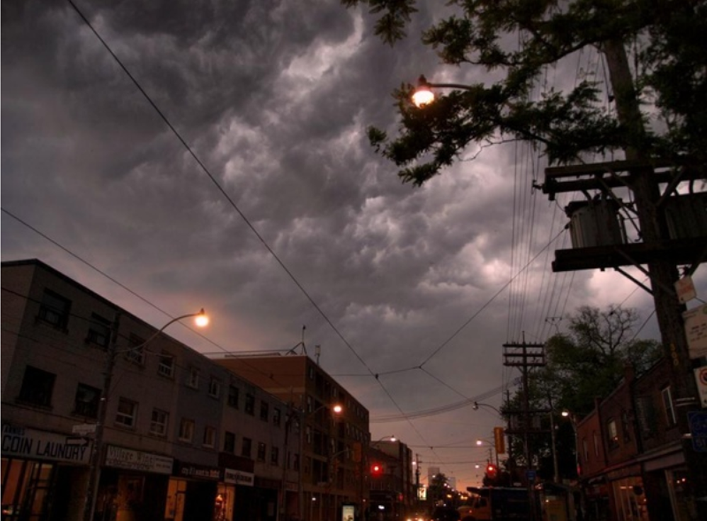
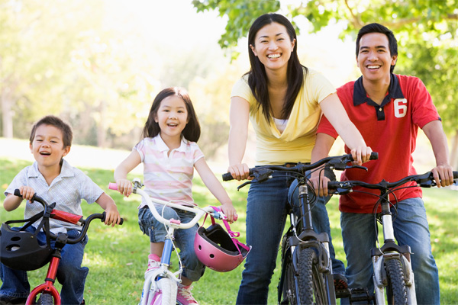
Community Action
A Quick Guide to Organizing for action on
climate change…
for Resilience
for a better future
For more information: www.canadaconserves.ca

Slide 2
The Climate Driver
Canada’s Climate Action Plans need action at the community level…
for Resilience
Help people and communities prepare for extreme weather events and power outages
Develop emergency response plans to help people during emergencies
For more information: www.canadaconserves.ca

Slide 3
The Climate Driver
Canada’s Climate Action Plans need action at the community level…
for a better future
Help communities create a vision and plan for a low-carbon future
Help people learn about and adopt climate solutions
Develop community projects for a better future.
For more information: www.canadaconserves.ca

Slide 4



Why organize?
Communities are the front lines of the climate campaign
1. Education / outreach
Municipality /
Community
Flow information to the public
through sources they trust
2. Visioning / planning
Engage communities in a vision
and a plan for their future. Turn
challenges into opportunities.
Groups
3. action
Help groups and local leaders
develop projects in support of
community goals
Public
For more information: www.canadaconserves.ca

Slide 5
Why organize?
Improved Action on Our national priorities
The traditional approach to public outreach and community engagement is linear and inefficient.
Organizations
Programs
Community leads
Public Action
For more information: www.canadaconserves.ca

Slide 6

Why organize?
Improved Action on Our common priorities
Communities can:
Collaborative Organizing
help deliver provincial and national programs
help municipalities deliver community programs
use groups and volunteers to reach residents and local businesses
Organizations
Programs
Networks
Municipalities
Community Networks
Projects
Public
For more information: www.canadaconserves.ca

Slide 7
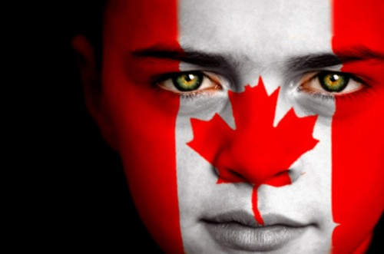
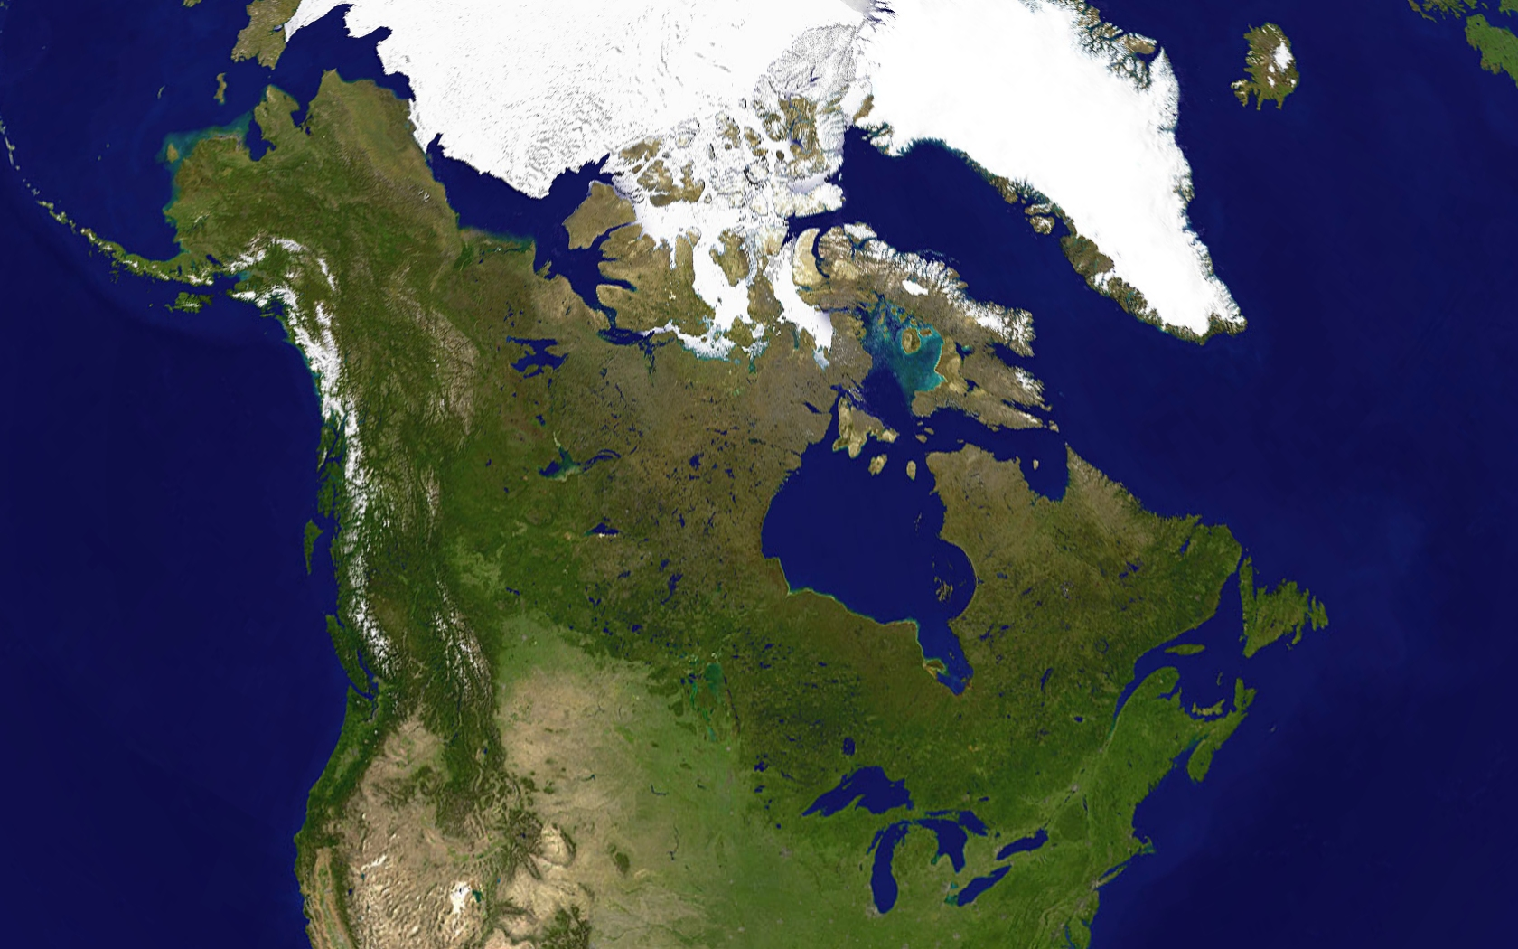
Why organize?
We can Reach Canadians
We are over 35 million people
Over 80 percent of us live in urban areas
There are over 3,600 municipalities across Canada
Each community has at least twenty community groups, schools, faith and cultural groups
Over 300 municipalities are part of the Partners for Climate Protection program of the Federation of Canadian Municipalities
For more information: www.canadaconserves.ca

Slide 8
Community Types
A community is people connected by a common bond
1. Neighbourhood
Neighbourhood
Other Interests
Culture / Faith
We all want our neighbourhoods to be a great place to live.
2. Culture / Faith
Culture and faith are two major types of communities built on heritage, beliefs, and values.
3. Other Interests
Communities of people form around all types of interests
Community action finds common interest between national and community priorities.
For more information: www.canadaconserves.ca

Slide 9

Community Action
Low-cost and effective Organizing
Let’s start with a simple and generic approach to organizing…

Slide 10
Community Action
Low-cost and effective Organizing
Seven steps to results
1. A Lead Group
3. A Community Network
4. A Community Scan
5. An Action Plan
7. Celebration and Review
6. Campaigns and Projects
2. A Coordinator
Find common goals for the community
Empower groups and people to act
Celebrate success

Slide 11
Community Action
Low-cost and effective Organizing
Seven steps to results
1. A Lead Group
3. A Community Network
4. A Community Scan
5. An Action Plan
7. Celebration and Review
6. Campaigns and Projects
2. A Coordinator
An existing group or a new group that can lead in community action.
Include a cross section of representation from the community
Look for people who can make things happen – community sparks!

Slide 12
Community Action
Low-cost and effective Organizing
Seven steps to results
1. A Lead Group
3. A Community Network
4. A Community Scan
5. An Action Plan
7. Celebration and Review
6. Campaigns and Projects
2. A Coordinator
Appoint a coordinator to help guide the process
The coordinator can be either municipal staff, a community leader, a contract position, or a volunteer

Slide 13
Community Action
Low-cost and effective Organizing
Seven steps to results
1. A Lead Group
3. A Community Network
4. A Community Scan
5. An Action Plan
7. Celebration and Review
6. Campaigns and Projects
2. A Coordinator
Groups to include: ratepayers, health and social services, faith, environmental, arts and culture, and business associations
Develop a network of organizations and individuals
Most communities can list up to 40 groups

Slide 14
Community Action
Low-cost and effective Organizing
Seven steps to results
1. A Lead Group
3. A Community Network
4. A Community Scan
5. An Action Plan
7. Celebration and Review
6. Campaigns and Projects
2. A Coordinator
Document who is doing what
Identify community priorities and a common vision
Identify projects ideas

Slide 15
Community Action
Low-cost and effective Organizing
Seven steps to results
1. A Lead Group
3. A Community Network
4. A Community Scan
5. An Action Plan
7. Celebration and Review
6. Campaigns and Projects
2. A Coordinator
Highlight ways to turn a community vision into reality
Include major projects, new ideas and community campaigns
Publish and promote

Slide 16
Community Action
Low-cost and effective Organizing
Seven steps to results
1. A Lead Group
3. A Community Network
4. A Community Scan
5. An Action Plan
7. Celebration and Review
6. Campaigns and Projects
2. A Coordinator
Launch a community-wide campaign and/or support projects
Groups can help with outreach and engagement
Build community-wide participation and support

Slide 17
Community Action
Low-cost and effective Organizing
Seven steps to results
1. A Lead Group
3. A Community Network
4. A Community Scan
5. An Action Plan
7. Celebration and Review
6. Campaigns and Projects
2. A Coordinator
Celebrate your successes
Review the plan and prepare for next year.
Plan deeper projects and campaigns

Slide 18

Community Action
A community climate action plan
Now let’s adapt the process to focus on climate action…

Slide 19
Community Action
A community climate action plan
A similar process
1. A Green Group
3. A Community Network
4. A Community Scan
5. An Action Plan
7. Celebration and Review
6. Campaigns and Projects
2. A Coordinator
A local green group or committee as lead
Projects that connect climate action and local priorities
A community climate action campaign

Slide 20
Community Action
A community climate action plan
Imagine a network of community leaders, local groups and volunteers:
PLANNING
Planning for extreme weather crises
Mapping a vision of a low carbon community
Drafting a community action plan to support local projects
ACTING
Hosting a community climate fair
Hosting workshops and open houses on conservation and renewable power
Promoting safe cycling
Starting community gardens
Greening parks and schools
Running community challenges

Slide 21

Community Action
A community climate action plan
Imagine a community-wide campaign to promote climate action:
LOCAL BUSINESS
Internal actions
Products and services
Community support
Trailblazing
Carbon neutral
INDIVIDUAL
Climate ready
Saving energy
Building community
Trailblazing
Carbon neutral

Slide 22
Community Action
Our best advice
Community action can be complex, or simple. Our best advice is to keep it simple.
Keep your organizing lean.
Find allies and opportunities.
  Build on the strengths of your local network
  Support creativity and innovation
Find common ground.
  Connect climate solutions with local priorities and needs
  See where your interests mesh with municipal, provincial and national goals and support programs.
Focus on helping groups and people

Slide 23
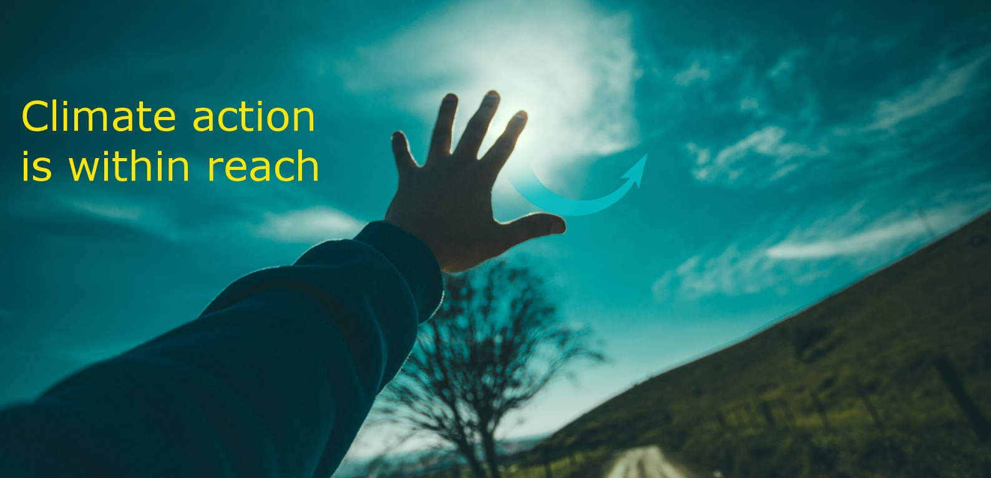
Community Action
We can help…
You are not alone. Reach out for help from….
climate leaders within your community
groups that have resources to help with local projects
other communities and community networks to share stories and resources
your governments and other agencies for information and funding support where available
For more information: www.canadaconserves.ca

Slide 24

Community Action
We can help…
for more information, contact:
www.climateaction.ca
For more information: www.canadaconserves.ca

